Slide 1
Quality of Living assessment for Indian Cities
By : Vidushi pandey

Slide 2
Introduction
An assessment of quality of life in any place plays an important role in many important decisions people make.
As per Mercer’s quality of living reports, the assessment of quality of living in any place depends on the following availability of factors :
Consumer goods
Economic environment
Housing
Medical and health considerations
Natural environment
Political and social environment
Public services and transport
Recreation
Schools and education
Socio-cultural environment

Slide 3
Objective
In this project our objective is to
“Classify major Indian cities based on different levels of quality of living offered by them to a citizen”

Slide 4
Data Requirement
List of Indian Cities
To start with we will need a list of various Indian cities that we will be classifying under this project. Such list is available on the following Wikipedia page :
https://en.wikipedia.org/wiki/List_of_cities_in_India_by_population
Latitude & Longitude of the cities
We will use the geocoder package in Python to extract latitude and longitude of each city.
Foursquare data
Upon entering the details of each city in the Foursquare API we get a list of venues in that city. The venues have different categories such as cafes, diners, schools, parks, metro station, libraries etc.

Slide 5
Data Requirement
Political and social environment
An important criteria under political and social environment which can be of great concern to people could be the crime rates in the city. To get this data we will mine the Wikipedia page :
https://en.wikipedia.org/wiki/List_of_states_and_union_territories_of_India_by_crime_rate
Since the data given in this page is as state level and not city level, we will map this data to each city depending on the state each city belongs to.
A combination of all the above mentioned data points will then be used in the next stage of analysis to classify cities as per the quality of living offered by them.

Slide 6
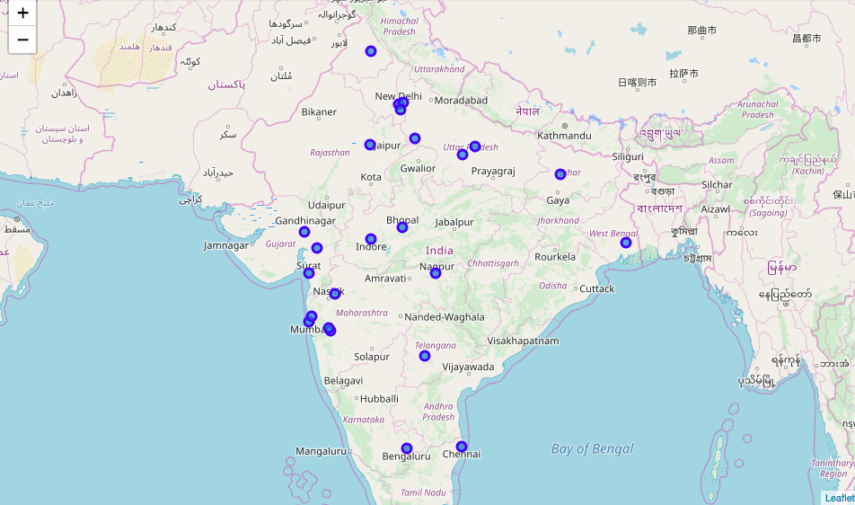
Representation of cities before assessment

Slide 7
Methodology
Web Scraping : For data collection from the Wikipedia Pages
Geocoder : In order to extract co-ordinates of each city in terms of its latitude & longitudes
Foursquare Api: In order to extract information about other factors such as educational facilities, recreational facilities, public services, Medical & Health care, socio-cultural environment etc
Quality of Living Index: There are many techniques for creation of Index mainly based on identifying the weights that should be given to each factor. For the purpose of this project we assume that the weight to each of the factors is equal and shall consider a quality of living index as :
Quality of Living Score = (Education Score+ Recreation Score + Public Service Score)-Crime Score
All the scores above have first been standardized

Slide 8
Results
City | Education | Public Service | Recreation | Population | Crime Percent | Quality_of_living_index | marker_color
Faridabad | 1.89888586 | 1.49777892 | 2.13830487 | -0.7826671 | -1.6749221 | 7.20989177 | green
Ghaziabad | 1.53759986 | 1.80603126 | 1.52615338 | -0.7045943 | 1.08127884 | 3.78850567 | blue
Ludhiana | -0.6401142 | -0.0046412 | 1.80150426 | -0.7144998 | -2.3957747 | 3.5525235 | blue
Vadodara | 1.5087128 | -0.0511725 | 0.7490279 | -0.6972184 | -0.8692634 | 3.07583162 | blue
Kolkata | 2.59169105 | -0.5473073 | -0.4943903 | 0.22559484 | -0.4452325 | 1.99522587 | blue
Pimpri-Chinchwad | 1.4379605 | -0.4496609 | 1.58315981 | -0.6782867 | 0.78445719 | 1.78700224 | yellow
Agra | -0.6401142 | 2.70158278 | 0.39931696 | -0.7255405 | 1.08127884 | 1.3795067 | yellow
Thane | -0.6401142 | 1.13057314 | 1.25543205 | -0.6404153 | 0.78445719 | 0.96143379 | yellow
Nashik | -0.6401142 | 0.94468692 | 0.61644454 | -0.7587044 | 0.78445719 | 0.13656005 | yellow
Ahmedabad | 0.64719725 | -0.7414085 | -0.7115285 | 0.60307925 | -0.8692634 | 0.0635236 | yellow
Patna | -0.6401142 | 1.01660062 | -1.0057713 | -0.6927536 | -0.6148448 | -0.0144401 | yellow
Jaipur | -0.6401142 | 0.68628811 | -0.4370061 | -0.2394984 | -0.3604263 | -0.030406 | yellow
Chennai | -0.6401142 | -0.1976077 | -0.5327976 | 0.29292879 | -0.4028294 | -0.9676901 | red
Hyderabad | -0.6401142 | -0.8717476 | -0.8576369 | 0.98708157 | -1.3781005 | -0.9913983 | red
Pune | 0.50897246 | -0.9200266 | 0.13096553 | -0.2134418 | 0.78445719 | -1.0645458 | red
Bangalore | -0.2145588 | -1.0708978 | -1.020847 | 1.55446883 | -0.8268603 | -1.4794433 | red
Surat | -0.6401142 | -0.9593345 | -0.9456059 | 0.23362267 | -0.8692634 | -1.6757912 | red
Bhopal | -0.6401142 | -0.1539584 | -0.462385 | -0.6548156 | 0.82686029 | -2.0833179 | red
Nagpur | -0.6401142 | -0.2424243 | -0.5231096 | -0.4526567 | 0.78445719 | -2.1901053 | red
Indore | -0.6401142 | -0.5762985 | -0.4151441 | -0.5996146 | 0.82686029 | -2.4584171 | red
Kanpur | -0.6401142 | -0.6253529 | -0.1431507 | -0.3329539 | 1.08127884 | -2.4898966 | red
Delhi | -0.3147478 | -1.0076138 | -1.1884625 | 2.41904563 | 0.02120155 | -2.5320257 | red
Lucknow | -0.6401142 | -0.6414559 | -0.1918683 | -0.3157291 | 1.08127884 | -2.5547173 | red
Mumbai | -0.6401142 | -0.7226335 | -1.2706054 | 2.88756872 | 0.78445719 | -3.4178103 | red

Slide 9
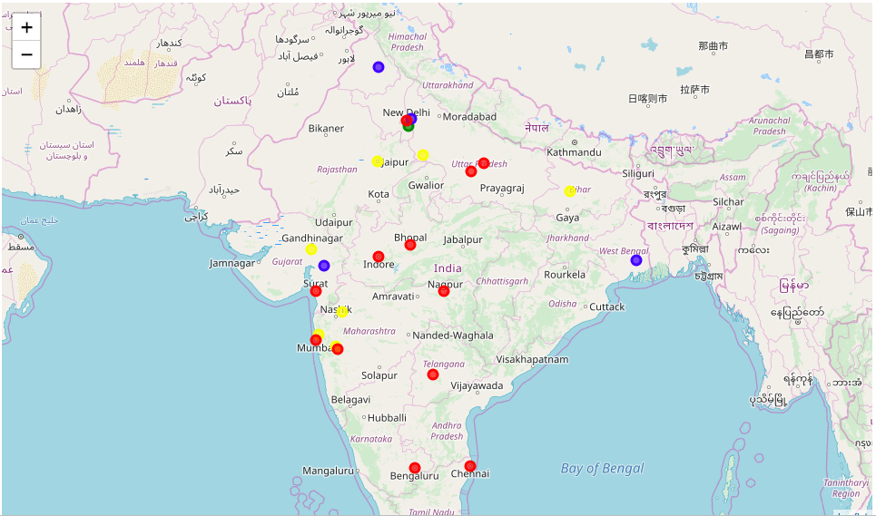
Results

Slide 10
Discussion
The resulting Quality of Living Indexed has been bucketed into four levels : -
Green : Highest score
Blue : Less than green
Yellow : Second Lowest
Red: Lowest scores
Only one city 'Faridabad' is green with highest Quality of Living score as 7.2
This is owing to positive and high scores all criteria of Education, Public Service & Recreation while having a low score for Crime percentage.
Other cities Specially the ones in Red have attained a low specially for Education & Public Services combined with higher population

Slide 11
Conclusion
Based on analysis of our results, we can conclude that for a city to improve its quality of living score it needs to improve upon facilities like Education, Recreation & Public Service in proportion to its population.
Also, focus needs to be given to specially improve upon Education Services & Public Services while trying to reduce Crime Rate

Slide 12
Limitations
Data provided by Foursquare API for Indian Cities was very limited. This may be the reason for the cities scoring so low specially for factors like Education, Public Services etc.
To improve upon the insights from analysis, it may be better to collect data for these criteria from other sources such as government records or United Nations reports.
Also advanced index creation techniques like Principal Component Analysis or Structural Equation Methods may be used for better results.

